Slide 1

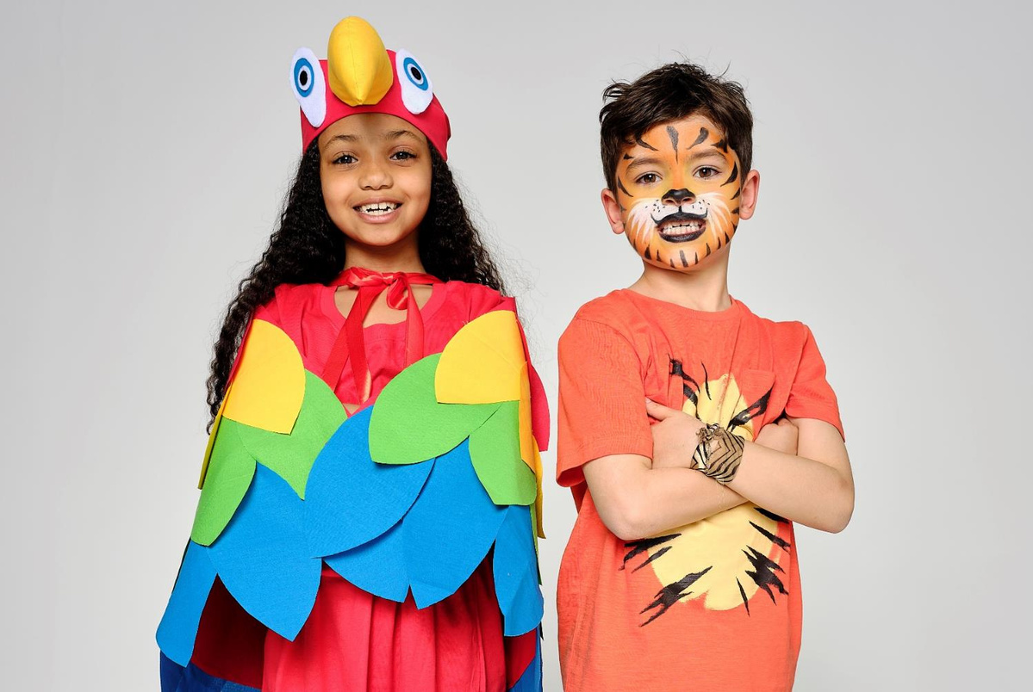
WEAR IT WILD

Slide 2
WHAT IS WEAR IT WILD?
  Wear it Wild is WWF’s schools fundraising event.
  In schools across the country, people will be wearing an item of wildlife-inspired fancy dress to raise funds, raise awareness and have grrrrrreat fun too!
  The funds raised will help protect our amazing world and its wildlife: like tigers, penguins and dolphins.
Notes:
2

Slide 3
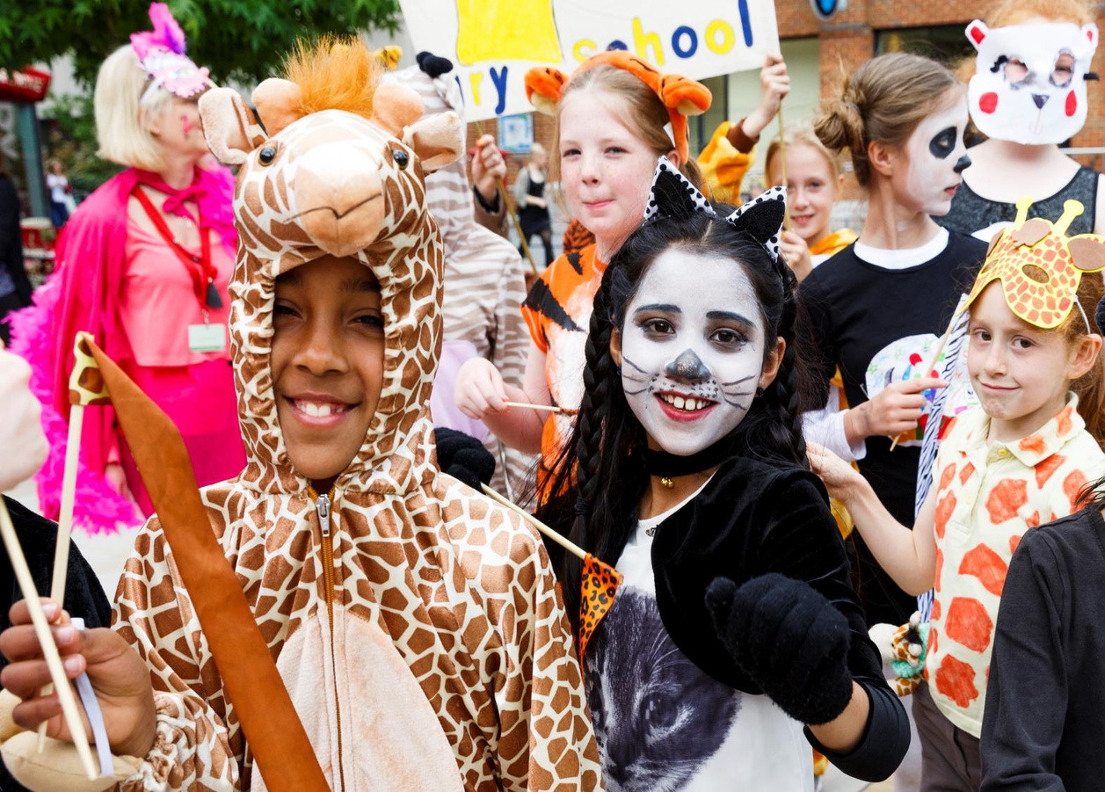
Notes:
© Tristan Fewings/WWF.
3

Slide 4
WHY IS WWF DOING THIS?
Around the world, we have lost 69% of our wildlife populations since 1970.
In Aotearoa New Zealand
  94% of our reptile species,
  82% of bird species,
  80% of bat species,
  76% of freshwater fish species,
  22% of marine mammal species
  are either facing extinction or are at risk of being threatened with extinction.
Notes:
4

Slide 5
TAKING PART IN WEAR IT WILD
By taking part in Wear it Wild, you’ll be helping WWF to protect some of our amazing wildlife, such as:
  Penguins
  Dolphins
  Albatrosses
  Sea Lions
  Tigers

Slide 6
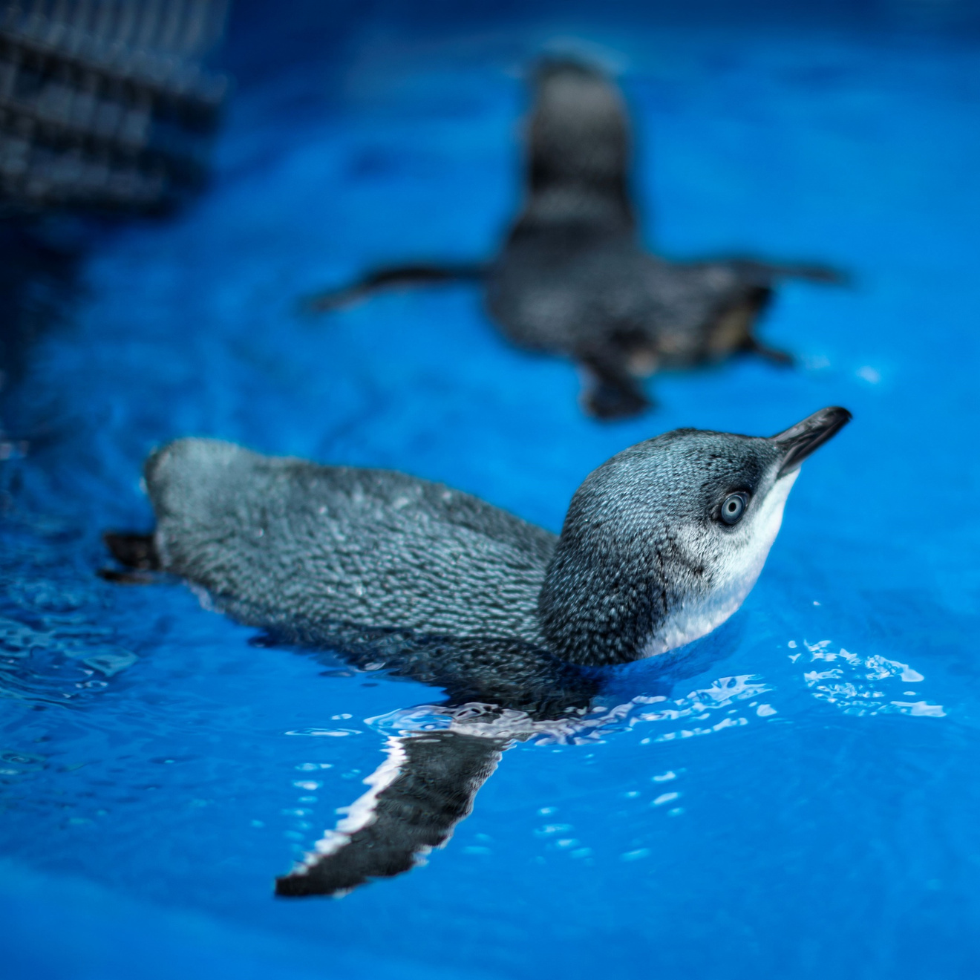
Notes:
© Leslie Stone
6

Slide 7
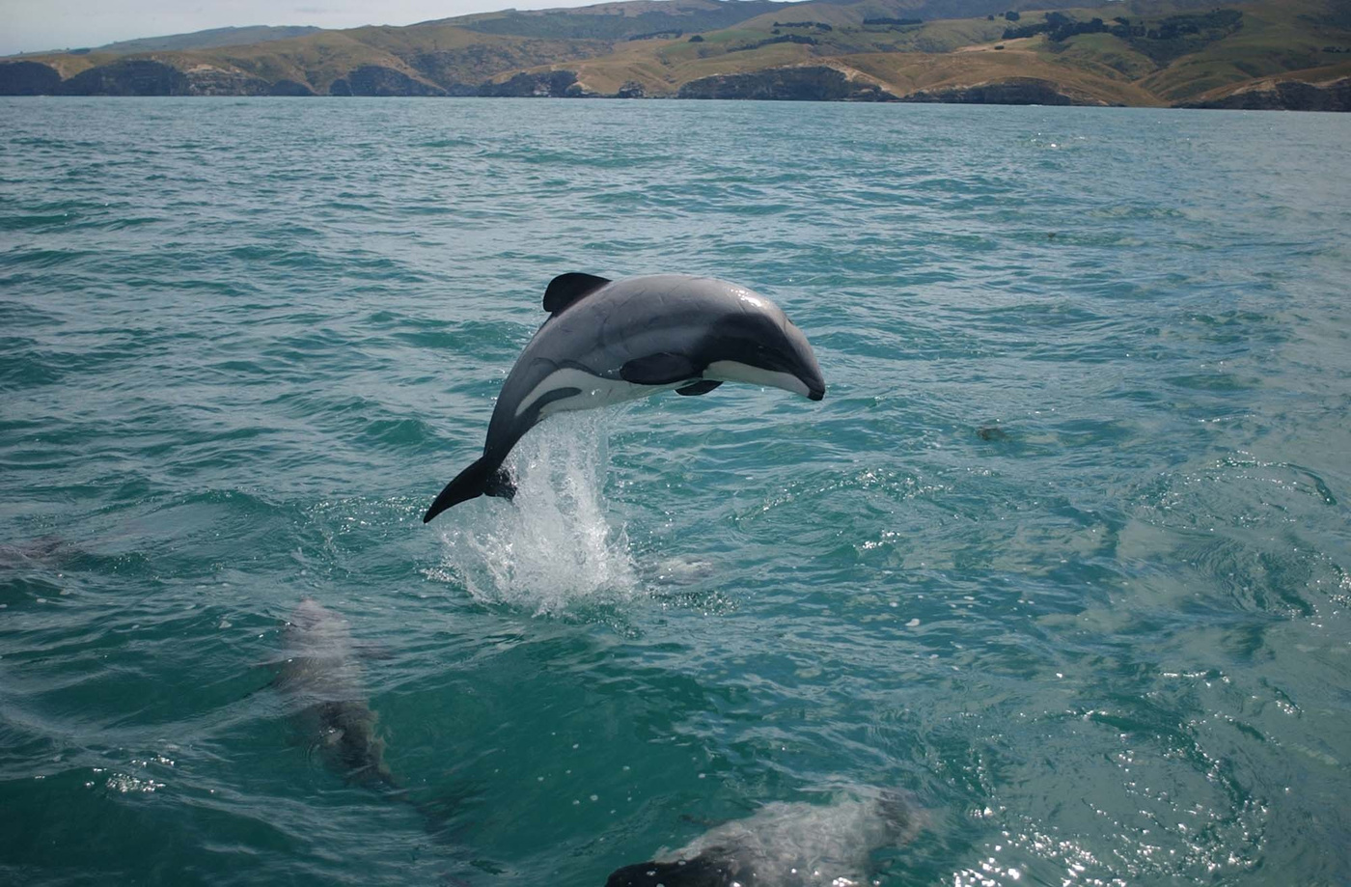
Notes:
© Will Rayment
7

Slide 8
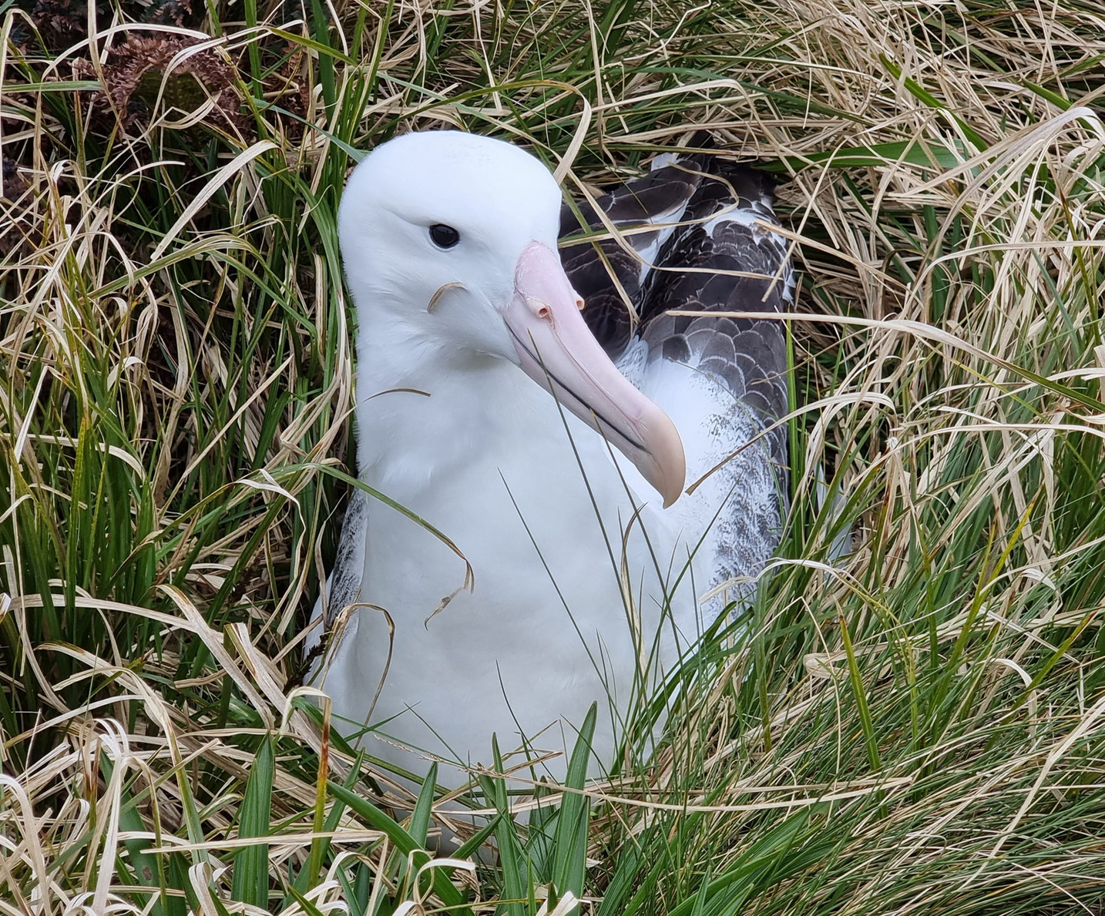
Notes:
© Lou Sanson
8

Slide 9
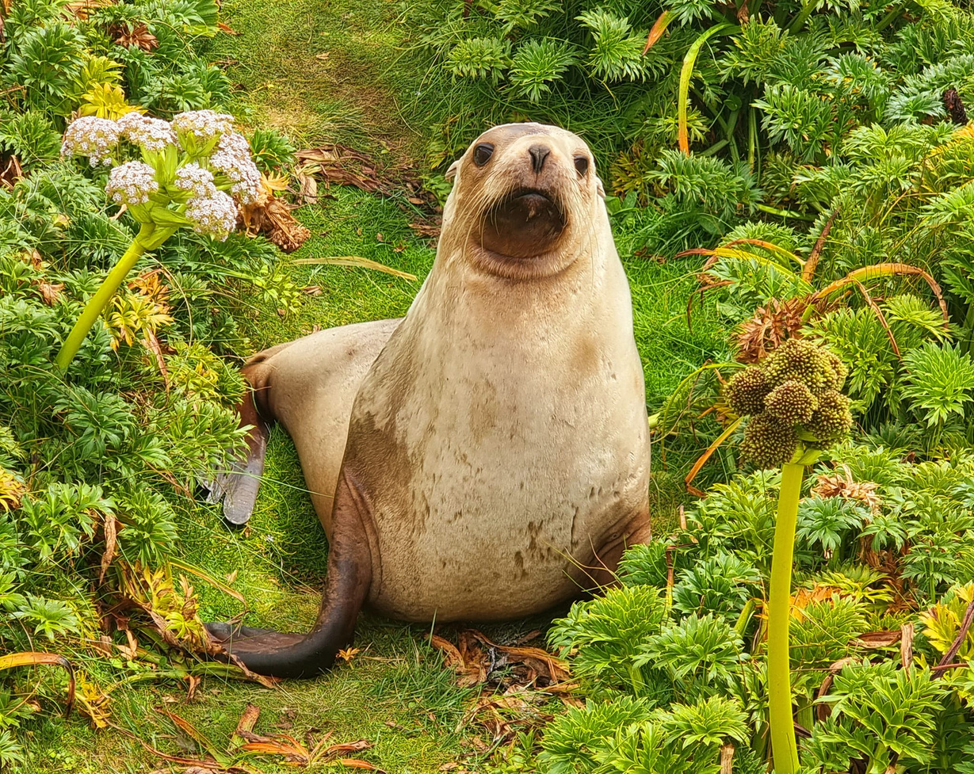
Notes:
© Lou Sanson
9

Slide 10
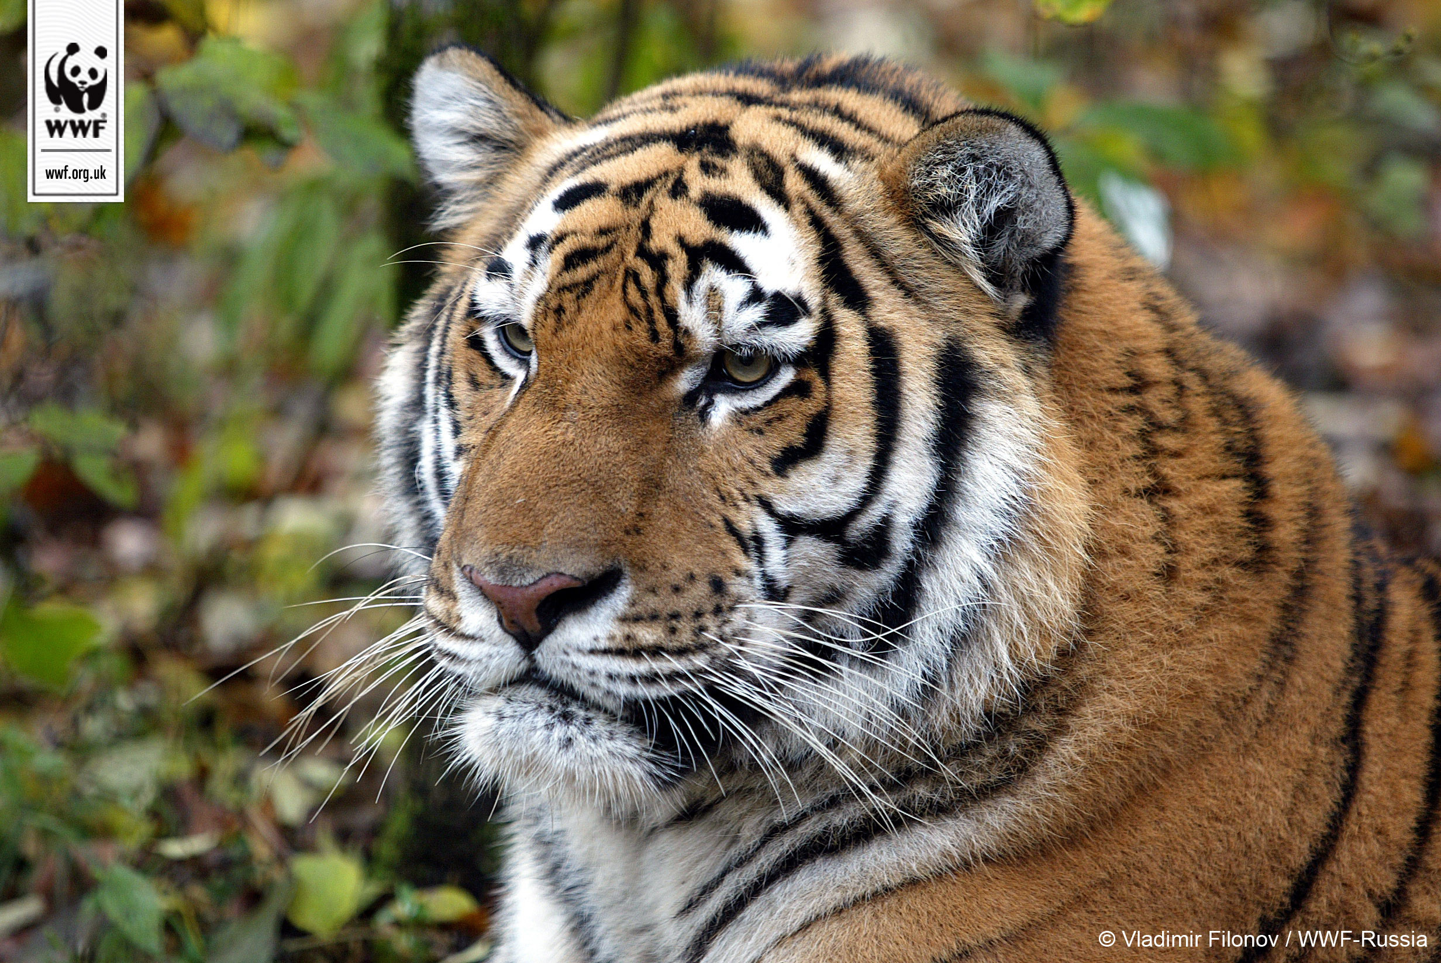
Notes:
© Naturepl.com Andy Rouse/WWF
10

Slide 11
IDEAS TO WEAR IT WILD
Here’s some ideas of what you can do to have a really wild day:
  Face-painting
  Create Wear it Wild masks
  Dress up in Wear it Wild outfits
  Organise a Wear it Wild cake sale
  Animal Olympics!
  What else can you think of?

Slide 12
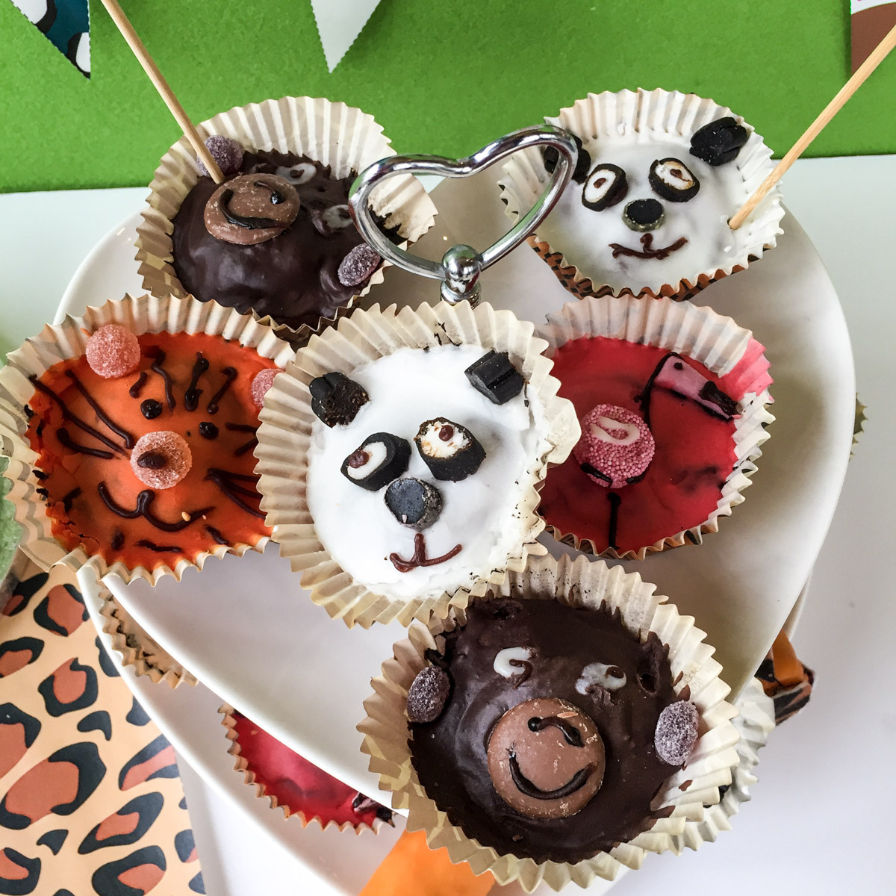

Slide 13
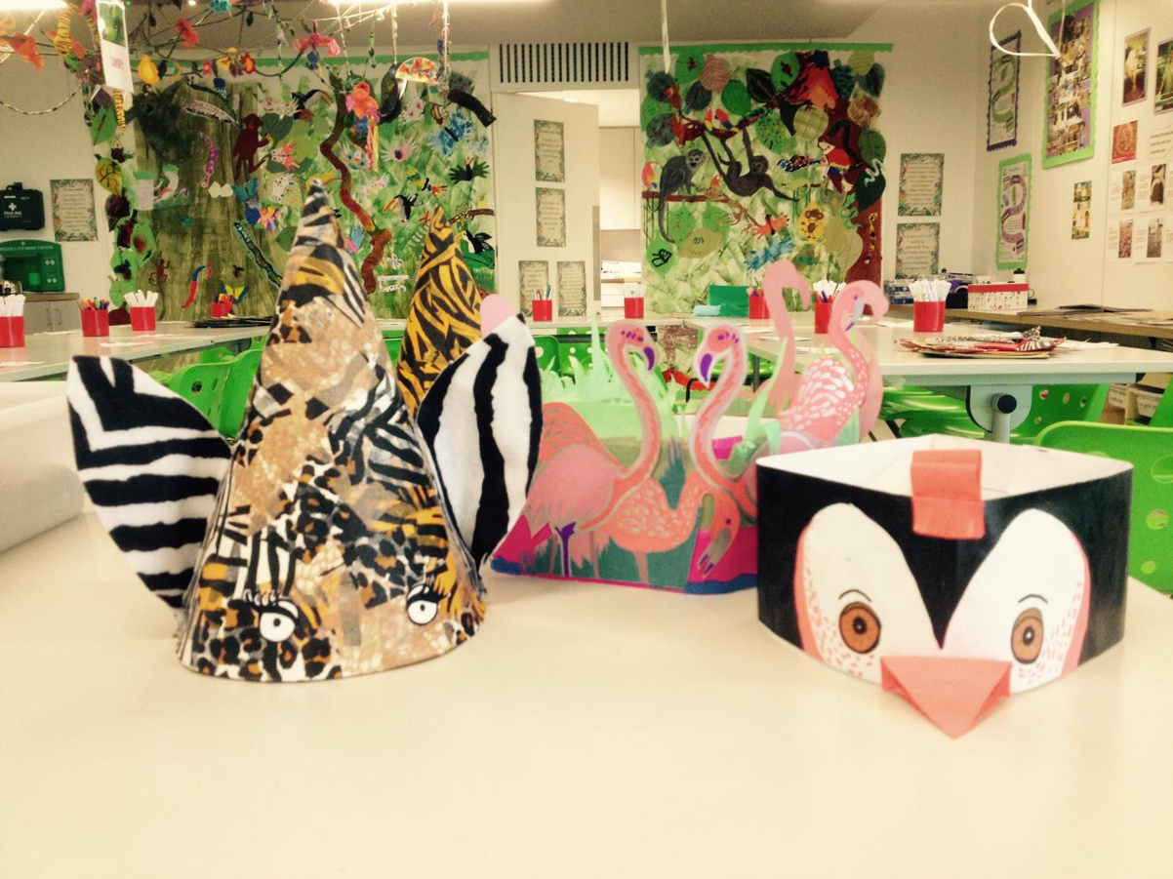

Slide 14
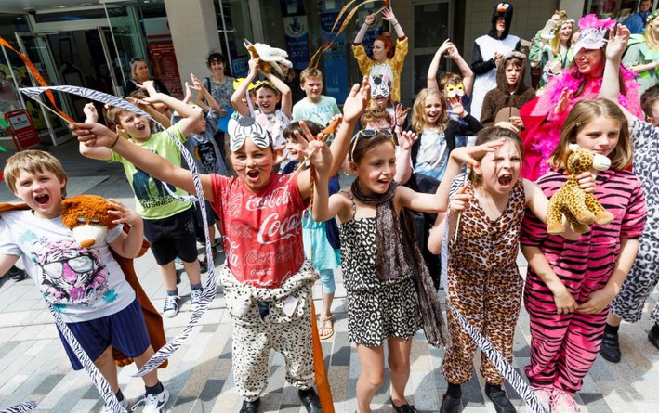
THANK YOU!
Thank you for taking part in Wear it Wild. Your kind support means a lot to us and we hope you all have a GRRRRRREAT Wear it Wild day!
Notes:
© Tristan Fewings/WWF.
14

